Slide 1


LEARNING ANALYTICS -
STUDENT PERFORMANCE
ANALYSIS AND PREDICTION
Open university learning analytics dataset
GUIDE:
STUDENT
DR. T. MALA
ASSOCIATE PROFESSOR
Department of IST
CEG
AADITYA PRABU K (2020115001)
MOHAMMED THABREZ G (2020115051)

Slide 2
INTRODUCTION
Learning Analytics (LA) focuses on the collection and analysis of learners’ data to improve their learning experience by providing informed guidance and optimizing learning materials
This Project mainly details
Meaningful indicators or metrics in a learning context.
Inter-relationships between these metrics using the concepts of Learning Analytics (LA) and Educational Data Mining (EDM).
Categorize students using K means Clustering Algorithm under Davies' Bouldin method.
1

Slide 3
INTRODUCTION
Visualization and Analysis of clusters.
The important features affecting students' performance.
Prediction of students' final results based on the interactional, course, and grade factors using various prediction models.
Analysis and choosing best model for prediction
2

Slide 4



PROBLEM STATEMENT
To understand the factors affecting student performance and dropout using data mining techniques:
To understand student performance and drop out
To categorize students based on their performance factor
To predict student performance using various models and choosing the best model
3

Slide 5
LITERATURE SURVEY
S.No | Author & Title | Problem Statement | Solution | Future Work
1 | Skand Arora , Manav Goel , A. Sai Sabitha & Deepti Mehrotra . | Understand the factors that reflect the students’ intention and involvement in academics using k means ++ clusterization | more event-based learning activities can be added to enhance student involvement and retention in the course; thereby one segment of learners can be pushed to the other segment or push each segment of learners. | Research work can be extended by mapping the learners to different learning styles and can be used to construct a learner’s model.
2 | Application of learning analytics using clustering data Mining for Students’ disposition analysis - Bharara, S., Sabitha, S., & Bansal, A. . | To find meaningful indicators or metrics in a learning context using the concepts of Learning Analytics and Educational Data Mining. | Designing a learning management system to collect data, track activity, and providing its access to enrolled students. | To use mixed-method evaluation approaches to study the inter-relationships between the different features.
4

Slide 6
LITERATURE SURVEY
S.No | Author & Title | Problem Statement | Solution | Future Work
3 | Journal of medical systems - Francis, B. K., & Babu, S. S. | on validating and developing mathematical models that can be used to predict the academic performance | shows that there is a strong relation between behavior of learner and their academic performance of the students. | In future the model could be extended further to support huge varieties of features of the student dataset.
4 | Online Academic Course Performance Prediction Using Relational Graph Convolutional Neural Network - Karimi, H., Derr, T., Huang, J., & Tang, J. | To harness the interactions of students with an online platform and accurately predict the course outcome | Deep Online Performance Evaluation (DOPE) DOPE utilizes an LSTM for harnessing the student behavior data into a condensed encoding, as the data has a natural inherent sequential form. | More advanced ways of handling behavioral data could be investigated. Analyze the imbalance and sparse issues of the dataset.
5

Slide 7
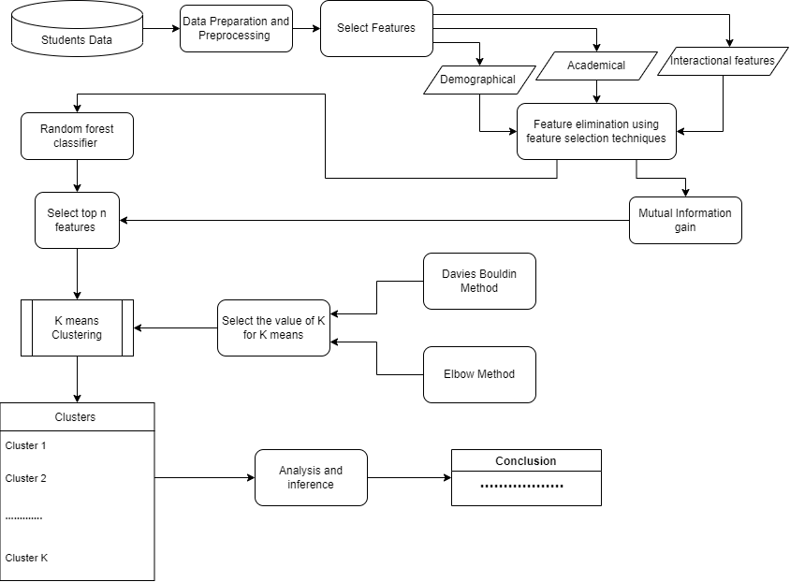
ARCHITECTURE DIAGRAM
STUDENT PERFORMANCE ANALYSIS
6

Slide 8
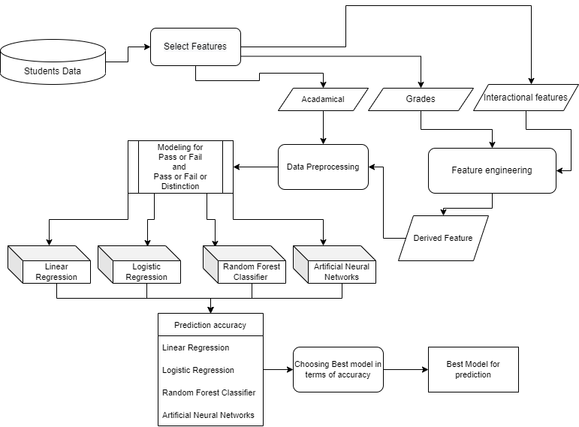
ARCHITECTURE DIAGRAM
2.STUDENT PERFORMANCE PREDICTION
7

Slide 9

METHODOLOGY
STUDENT PERFORMANCE ANALYSYS
Data preparation and Preprocessing
Feature selection and Feature elimination
K means Clusterization under Davies bouldin method
Analysis and Conclusion.
8

Slide 10
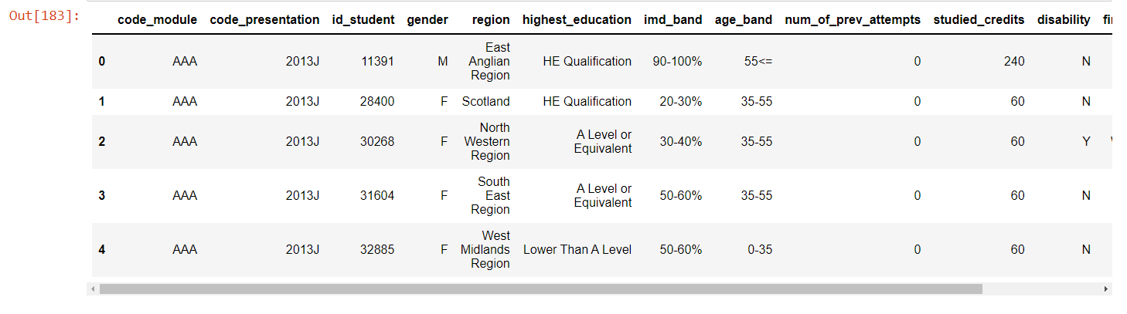
Tables were selected based on Physical factor, Demographical factor, Educational factor, Interactional factor and merged.
9

Slide 11
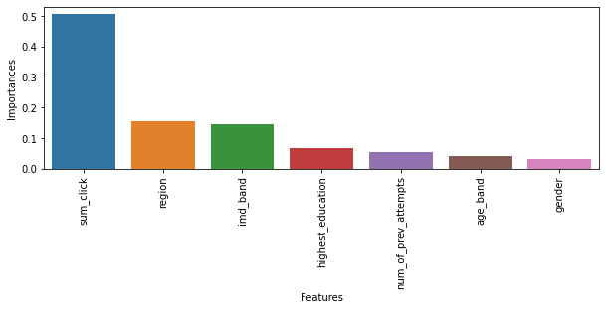
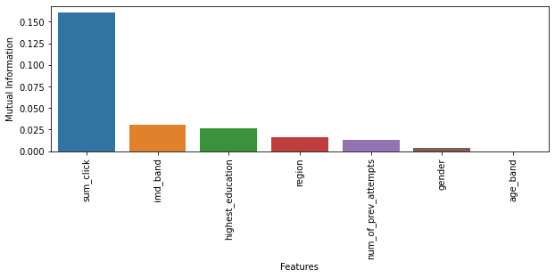
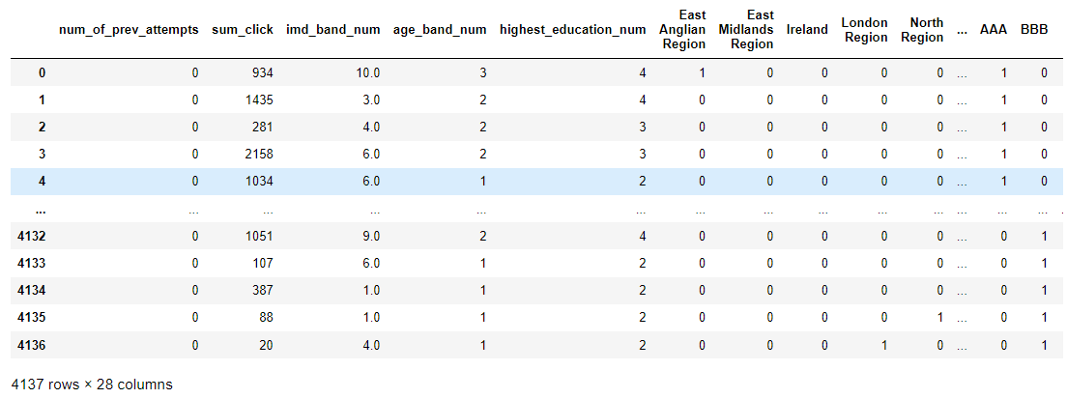
Feature elimination using feature selection techniques
Random forest classifier
Mutual information gain
Categorical data cleaning
and
Min Max Normalization
10

Slide 12
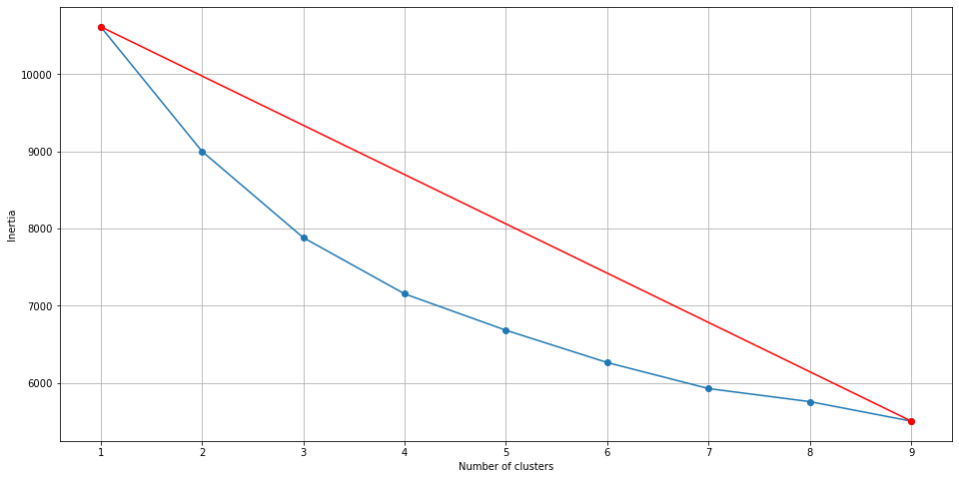
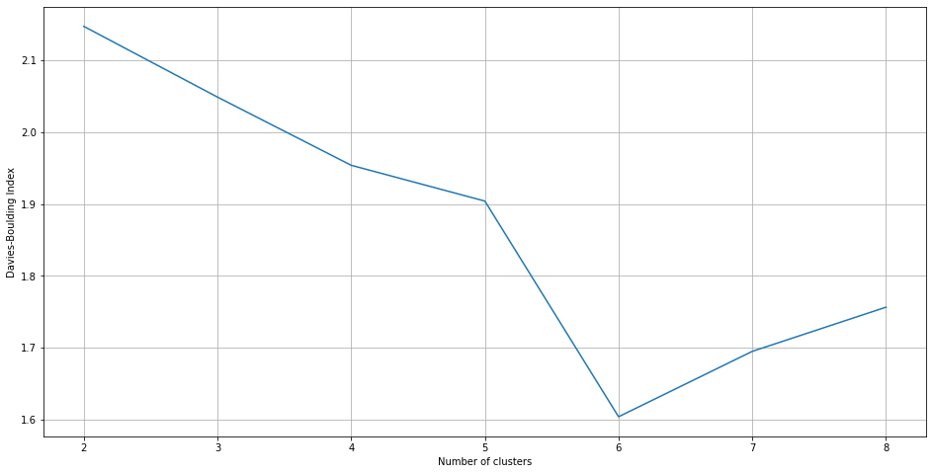
Finding K value for K-Means using two methods
Elbow Method
Davies bouldin method
The obtained k value for the Elbow method is four and for Davies Bouldin method is six. When the number of clusters increases the splitting of data also increases, hence it is easier to identify trends when k is six than when k is four. Hence six is chosen as the K value for K means Clusterization.
11

Slide 13
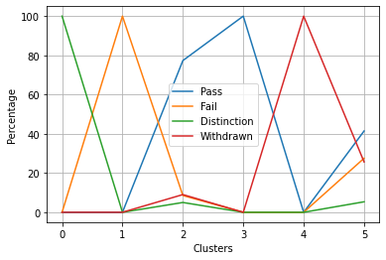
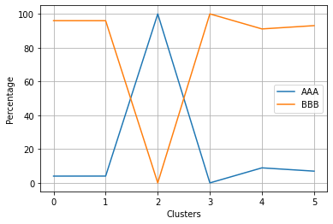
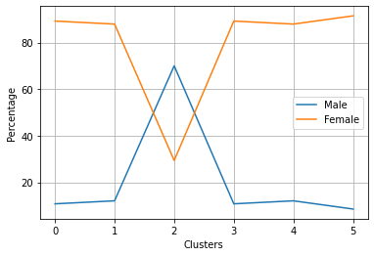
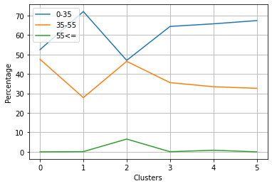
Final result
Code Module
Fig 1
Fig 2
Gender
Age band
Fig 3
Fig 4
12

Slide 14
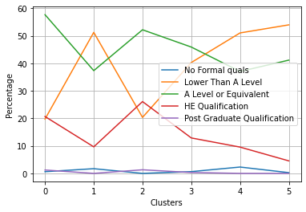
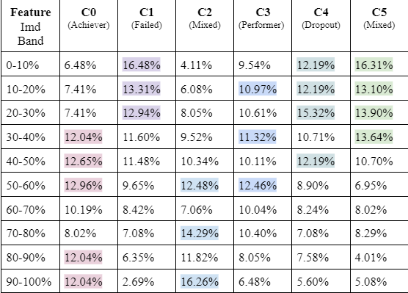
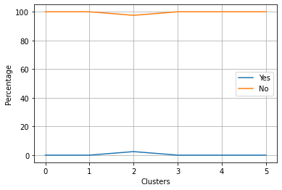
Higest education
Imd band
Fig 5
Disability
13
Fig 6
Fig 7

Slide 15
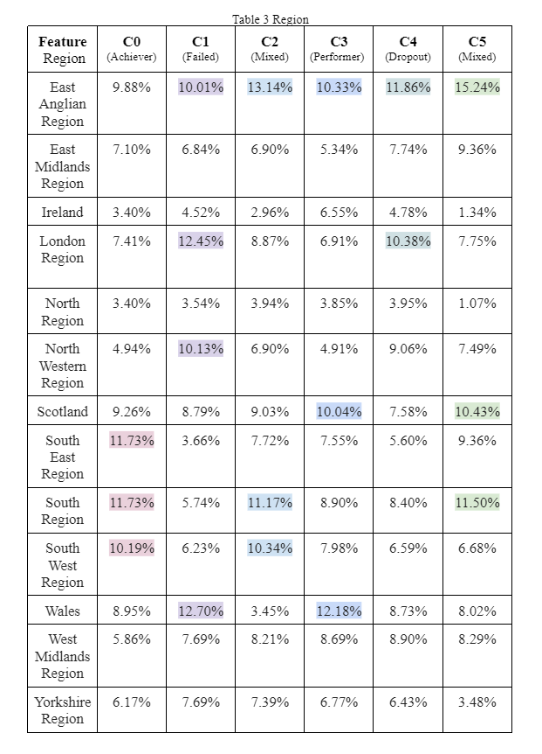
Region
Fig 8
Fig 9
14

Slide 16
CONCLUSION
Students are categorized as Achievers, Performers, Failed, Dropouts and Mixed (fig 1)
The study shows that the Majority of the students are from the East Anglian region. (fig 8)
Dropouts are mostly from East Anglian Region and London Region. (fig 8)
Similarity exist between Failed students and Dropouts in regional and highest educational factors. (fig 5,8,9)
There is a larger number of females of the age group 35-55 actively participating in online education. (fig 3,4)
The student's performance mainly depends on their interest in learning despite a poor Imd Band index students were able to score distinction.(fig 7)
Disability does not affect the student performance majorly in this scenario.(fig 6)
The level of highest education of a student is directly dependent on the student’s understanding of the course. (fig 1,5)
Course BBB is popular and also difficult amongst students.(fig 2)
15

Slide 17
METHODOLOGY
STUDENT PERFORMANCE PREDICTION
Data preparation and Feature engineering
Data Preprocessing
Prediction Modelling
Choosing the best Model for prediction
16

Slide 18
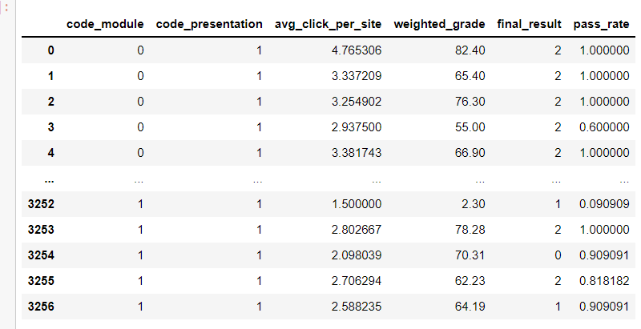
Pass rate = No of assessments passed by a student in a module presentation / Total number of assessments present in the module presentation
Weighted grade = Weighted Grade which is the sum of all weighted assessment scores of a student in a module-presentation.
Average click per site = Total number of clicks done by the student / Total number of sites visited by the student
17

Slide 19
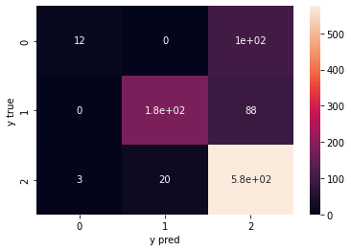
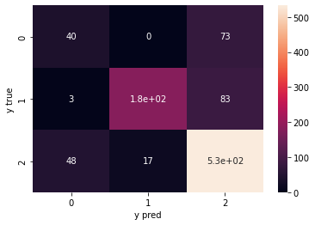
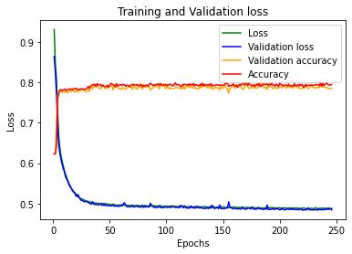
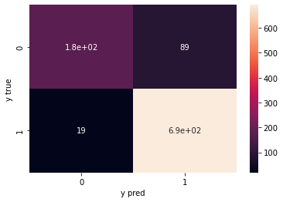

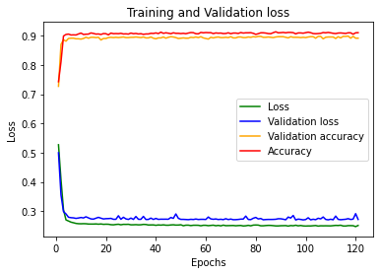
Logistic regression
Random Forest Classifier
Artificial Neural Networks
Pass or Fail or Distinction
Pass or Fail
18

Slide 20
CONCLUSION
MODEL | BINARY CLASSIFICATION | MULTI-CLASS CLASSIFICATION
LINEAR REGRESSION | 0.53 | 0.027
LOGISTIC REGRESSION | 0.90 | 0.79
RANDOM FOREST CLASSIFIER | 0.89 | 0.79
ARTIFICIAL NEURAL NETWORK | 0.91 | 0.80
Artificial Neural Networks gives the best accuracy:
80 % for Pass/Fail/Distinction Prediction (Multi-Class Classification)
91% for Pass/Fail Prediction (Binary Classification).
19

Slide 21
REFERENCES
Francis, B. K., & Babu, S. S. (2019) Predicting academic performance of students using a hybrid data mining approach. Journal of medical systems.
Karimi, H., Derr, T., Huang, J., & Tang, J.(2020) Online Academic Course Performance Prediction Using Relational Graph Convolutional Neural Network.
Sandra Prusaka (2019) Student Failure | Modelling with a messy dataset.
Sanyam Bharara & Sai Sabitha & Abhay Bansal (2017) Application of learning analytics using clustering data Mining for Students’ disposition analysis.
Skand Arora , Manav Goel , A. Sai Sabitha & Deepti Mehrotra (2017) Learner Groups in Massive Open Online Courses, American Journal of Distance Education.
Victor Regis (2020) Student Performance Prediction: Complete analysis.
20

Slide 22

Thank you
for listening!

